Slide 1

Youth club
Channel

Slide 2

Introduction: -
Youth Club (YC) is a non-profit, non-sectarian, non-political organization, which provides a unique platform for the youth and provides them avenues to channel their potential in accordance with Islamic values. Since its inception in 2011, Youth Club is working to create well-balanced individuals, who are not only skilled in their respective fields but also recognize and fulfil their religious obligations and participate actively in their communities.

Slide 3
Team members: -
Raja Zia Ul Haq
CEO
Tuaha ibn Jalil Country Manager (Males)
Ali Ahtisham

Slide 4
Team members: -
Muhammad Ali Speaker At Youth Club
Khurram Alvi Speaker At Youth Club
Abu Saad Speaker at Youth Club

Slide 5
Guest speakers: -
Mariya Zahid Speaker at Youth Club
Dr. Farah Zeb Guest Speaker at Youth Club
Dr. Kanwal Kaiser Guest Speaker At Youth Club

Slide 6

You tube: -

Slide 7


Facebook: -
Instagram: -

Slide 8

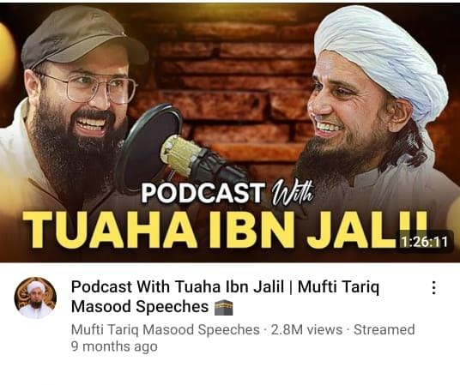
Most viewed videos: -

Slide 9
Thank you

